Slide 1
Introduction: Hello, World Below
Elements of Computing Systems, Nisan & Schocken, MIT Press, 2005 www.idc.ac.il/tecs
Usage and Copyright Notice:
Copyright 2005 © Noam Nisan and Shimon Schocken
This presentation contains lecture materials that accompany the textbook “The Elements of Computing Systems” by Noam Nisan & Shimon Schocken, MIT Press, 2005.
We provide both PPT and PDF versions.
The book web site, www.idc.ac.il/tecs , features 13 such presentations, one for each book chapter. Each presentation is designed to support about 3 hours of classroom or self-study instruction.
You are welcome to use or edit this presentation as you see fit for instructional and non-commercial purposes.
If you use our materials, we will appreciate it if you will include in them a reference to the book’s web site.
If you have any questions or comments, you can reach us at tecs.ta@gmail.com

Slide 2
The course at a glance
Objectives:
Understand how hardware and software systems are built,
and how they work together
Learn how to break complex problems into simpler ones
Learn how large scale development projects are planned and executed
Have fun
Methodology:
Build a complete, general-purpose, and working computer system
Play and experiment with this computer, at any level of interest.

Slide 3
Some course details
12 projects, can be done by pairs
Hardware projects are done and simulated in HDL
(Hardware Description Language)
Software projects can be done in any programming language of your choice (we recommend Java)
Projects methodology:
  Design (API) + test materials are given
  Implementation done by students
Tools: simulators, tutorials, test scripts
Book
Q&A policy
Exam.

Slide 4
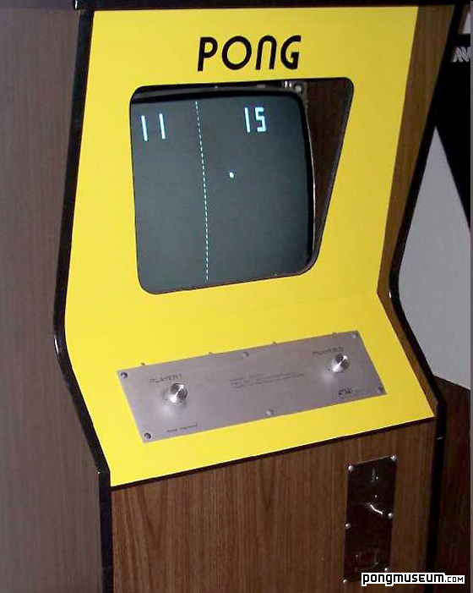
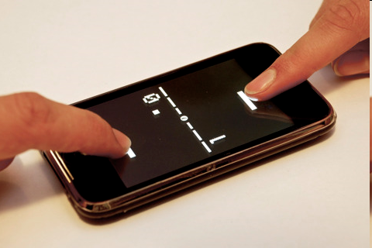
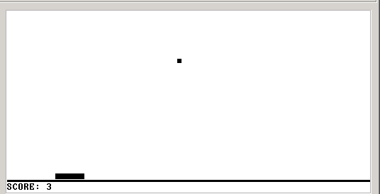
Demo
Pong, 1985
Pong, 2011
Pong, on our computer

Slide 5
Course theme and structure
Human
Abstract design
Software
Thought
abstract interface
hierarchy
Chapters 9, 12
H.L. Language
Compiler
&
abstract interface
Operating Sys.
Chapters 10 - 11
Virtual
VM Translator
Machine
abstract interface
Chapters 7 - 8
Assembly
Language
Assembler
Chapter 6
abstract interface
Computer
Machine
Architecture
Language
abstract interface
Chapters 4 - 5
Gate Logic
Hardware
abstract interface
Platform
Chapters 1 - 3
Electrical
Hardware
Chips &
Engineering
Logic Gates
Physics
hierarchy
(Abstraction–implementation paradigm)

Slide 6
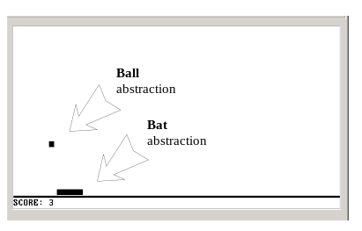
Application level: (say,) Pong

Slide 7
The big picture
Human
Abstract design
Software
Thought
abstract interface
hierarchy
Chapters 9, 12
H.L. Language
Compiler
&
abstract interface
Operating Sys.
Chapters 10 - 11
Virtual
VM Translator
Machine
abstract interface
Chapters 7 - 8
Assembly
Language
Assembler
Chapter 6
abstract interface
Computer
Machine
Architecture
Language
abstract interface
Chapters 4 - 5
Gate Logic
Hardware
abstract interface
Platform
Chapters 1 - 3
Electrical
Hardware
Chips &
Engineering
Logic Gates
Physics
hierarchy

Slide 8
High-level programming (Jack language)
/** A Graphic Bat for a Pong Game */
class Bat {
field int x, y; // screen location of the bat's top-left corner
field int width, height; // bat's width & height
// The class constructor and most of the class methods are omitted
/** Draws (color=true) or erases (color=false) the bat */
method void draw(boolean color) {
do Screen.setColor(color);
do Screen.drawRectangle(x,y,x+width,y+height);
return;
}
/** Moves the bat one step (4 pixels) to the right. */
method void moveR() {
do draw(false); // erase the bat at the current location
let x = x + 4; // change the bat's X-location
// but don't go beyond the screen's right border
if ((x + width) > 511) {
let x = 511 - width;
}
do draw(true); // re-draw the bat in the new location
return;
}
}
Typical call to an OS method

Slide 9
Operating system level (Jack OS)
/** An OS-level screen driver that abstracts the computer's physical screen */
class Screen {
static boolean currentColor; // the current color
// The Screen class is a collection of methods, each implementing one
// abstract screen-oriented operation. Most of this code is omitted.
/** Draws a rectangle in the current color. */
// the rectangle's top left corner is anchored at screen location (x0,y0)
// and its width and length are x1 and y1, respectively.
function void drawRectangle(int x0, int y0, int x1, int y1) {
var int x, y;
let x = x0;
while (x < x1) {
let y = y0;
while(y < y1) {
do Screen.drawPixel(x,y);
let y = y+1;
}
let x = x+1;
}
}
}

Slide 10
The big picture
Human
Abstract design
Software
Thought
abstract interface
hierarchy
Chapters 9, 12
H.L. Language
Compiler
&
abstract interface
Operating Sys.
Chapters 10 - 11
Virtual
VM Translator
Machine
abstract interface
Chapters 7 - 8
Assembly
Language
Assembler
Chapter 6
abstract interface
Computer
Machine
Architecture
Language
abstract interface
Chapters 4 - 5
Gate Logic
Hardware
abstract interface
Platform
Chapters 1 - 3
Electrical
Hardware
Chips &
Engineering
Logic Gates
Physics
hierarchy

Slide 11
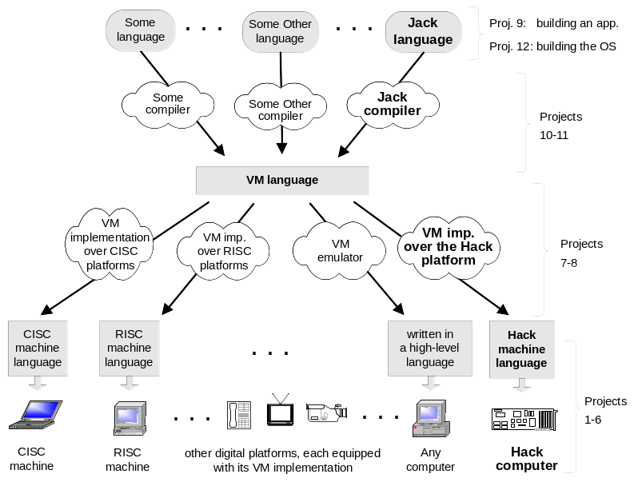
A modern compilation model

Slide 12
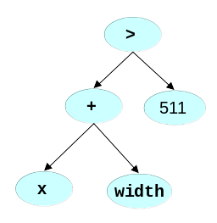
Compilation 101
Intermediate code
push x
push width
add
push 511
gt
Source code
parsing
Code
generation
(x + width) > 511
Abstraction
Syntax
Analysis
Parse
Tree
Semantic
Synthesis
Implementation
Observations:
Modularity
Abstraction / implementation interplay
The implementation uses abstract services from the level below.

Slide 13
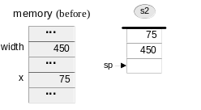
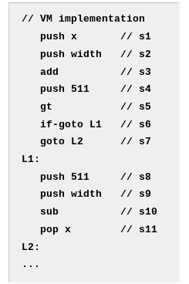
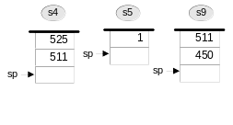
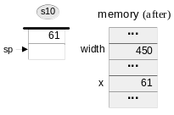
The Virtual Machine (our stack-based VM, quite similar to Java’s JVM)
if ((x+width)>511) {
let x=511-width;
}

Slide 14
The big picture
Human
Abstract design
Software
Thought
abstract interface
hierarchy
Chapters 9, 12
H.L. Language
Compiler
&
abstract interface
Operating Sys.
Chapters 10 - 11
Virtual
VM Translator
Machine
abstract interface
Chapters 7 - 8
Assembly
Language
Assembler
Chapter 6
abstract interface
Computer
Machine
Architecture
Language
abstract interface
Chapters 4 - 5
Gate Logic
Hardware
abstract interface
Platform
Chapters 1 - 3
Electrical
Hardware
Chips &
Engineering
Logic Gates
Physics
hierarchy

Slide 15
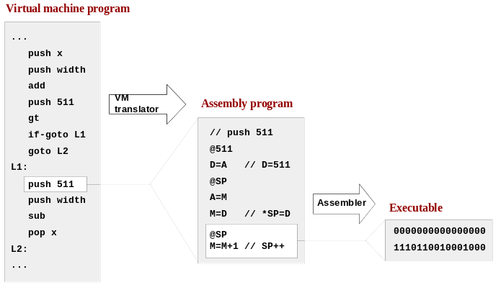
Low-level programming (on the Hack computer)
For now, ignore all details!

Slide 16
The big picture
Human
Abstract design
Software
Thought
abstract interface
hierarchy
Chapters 9, 12
H.L. Language
Compiler
&
abstract interface
Operating Sys.
Chapters 10 - 11
Virtual
VM Translator
Machine
abstract interface
Chapters 7 - 8
Assembly
Language
Assembler
Chapter 6
abstract interface
Computer
Machine
Architecture
Language
abstract interface
Chapters 4 - 5
Gate Logic
Hardware
abstract interface
Platform
Chapters 1 - 3
Electrical
Hardware
Chips &
Engineering
Logic Gates
Physics
hierarchy

Slide 17
Machine language semantics (Hack platform)
For now, ignore all details!
Code semantics, as interpreted by the Hack hardware platform
Instruction code
Address
(0=“address” inst.)
Code syntax
0
0 0 0 0 0 0 0 0 0 0 0 0 0 0 0
0000000000000000
@0
1111110111001000
M=M-1
1
1 1
1 1 1 0 1 1 1
0 0 1
0 0 0
Instruction code
ALU
Destination
Jump
(1=“compute” inst.)
operation code
Code
Code
(
M-1
)
(
M
)
(
no jump
)
We need a hardware architecture that realizes this semantics
The hardware platform should be designed to:
  Parse instructions, and
  Execute them.

Slide 18
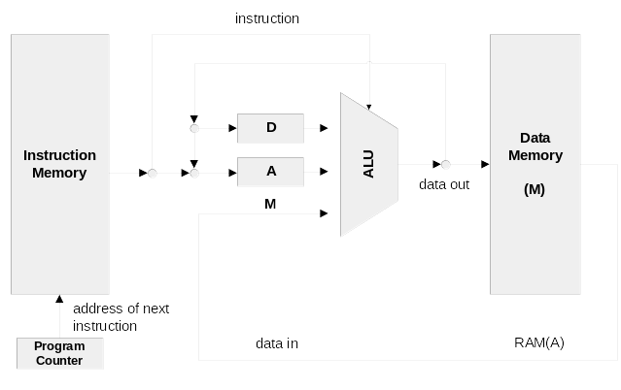
Computer architecture (Hack platform, approx.)
For now, ignore all details!
A typical Von Neumann machine

Slide 19
The big picture
Human
Abstract design
Software
Thought
abstract interface
hierarchy
Chapters 9, 12
H.L. Language
Compiler
&
abstract interface
Operating Sys.
Chapters 10 - 11
Virtual
VM Translator
Machine
abstract interface
Chapters 7 - 8
Assembly
Language
Assembler
Chapter 6
abstract interface
Computer
Machine
Architecture
Language
abstract interface
Chapters 4 - 5
Gate Logic
Hardware
abstract interface
Platform
Chapters 1 - 3
Electrical
Hardware
Chips &
Engineering
Logic Gates
Physics
hierarchy

Slide 20
Logic design
Combinational logic (leading to an ALU)
Sequential logic (leading to a RAM)
Putting the whole thing together (leading to a Computer)
Using … gate logic.

Slide 21
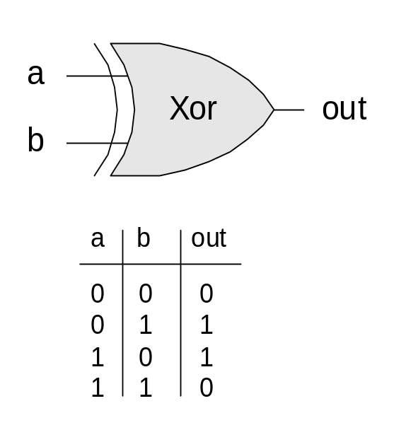
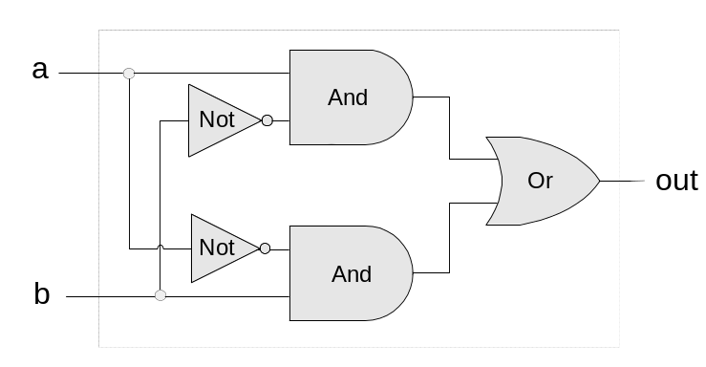
Gate logic
Hardware platform = inter-connected set of chips
Chips are made of simpler chips, all the way down to logic gates
Logic gate = hardware element that implements a certain Boolean function
Every chip and gate has an interface, specifying WHAT it is doing, and an implementation, specifying HOW it is doing it.
Interface
Implementation

Slide 22
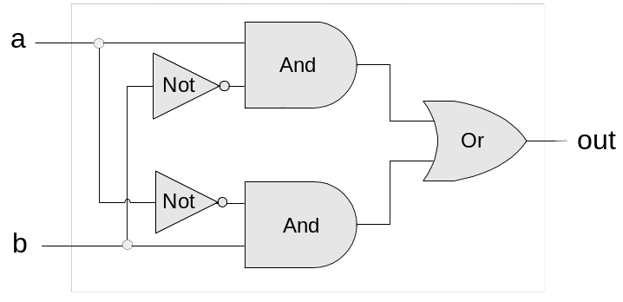
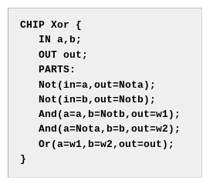
Hardware Description Language (HDL)

Slide 23
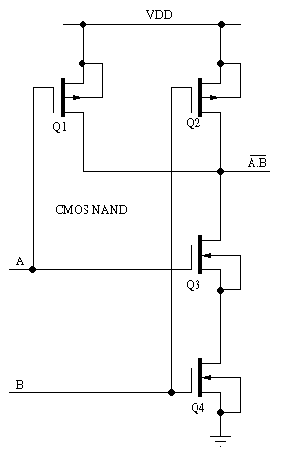
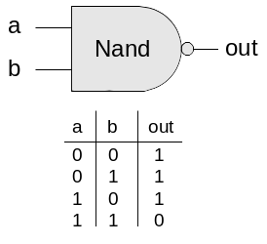
The tour ends:
Interface
One implementation option (CMOS)

Slide 24
The tour map, revisted
Human
Abstract design
Software
Thought
abstract interface
hierarchy
Chapters 9, 12
H.L. Language
Compiler
&
abstract interface
Operating Sys.
Chapters 10 - 11
Virtual
VM Translator
Machine
abstract interface
Chapters 7 - 8
Assembly
Course overview:
Building this world,
from the ground up
Language
Assembler
Chapter 6
abstract interface
Computer
Machine
Architecture
Language
abstract interface
Chapters 4 - 5
Gate Logic
Hardware
abstract interface
Platform
Chapters 1 - 3
Electrical
Hardware
Chips &
Engineering
Logic Gates
Physics
hierarchy

